Slide 1
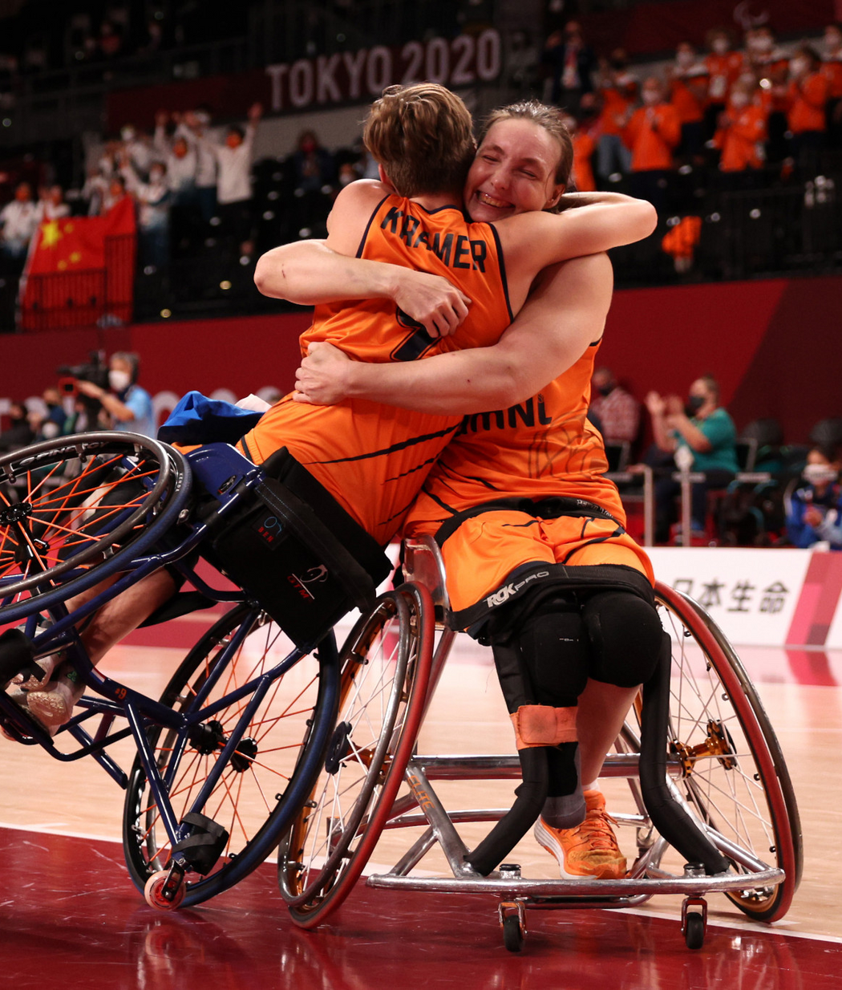
OPEN PRESENTATION
PROJECT WHEELS
08-10-2021
created by: Collin van adrichem
Jake van der Valk
Sjoerd Rietveld
Martijn Kok
Alejandro Oliver Llorente
Daan Gielen
Notes:
welcome to the presentation of team wheels.
team wheels consist of the next teammates
in this presentation we are going to give you all an inside loo k in our project.

Slide 2
INTRODUCTION
Project background story
Research question & sub questions
REQUIREMENTS
must haves should haves could haves
TABLE OF CONTENT
PROJECT ACTIVITIES
ways to accomplish the requirements
END RESULT
products the project group deliver
Notes:
in this presentation we will take a look at the next 4 themes
introduction:
short story about the problem. presenting the researchquestion and subquestions.
requirements:
here we will present the must haves, should haves & could haves of the result.
project activities:
pesenting all of the activites to accomplish the rquirements.
end result:
the products the project group will deliver.

Slide 3
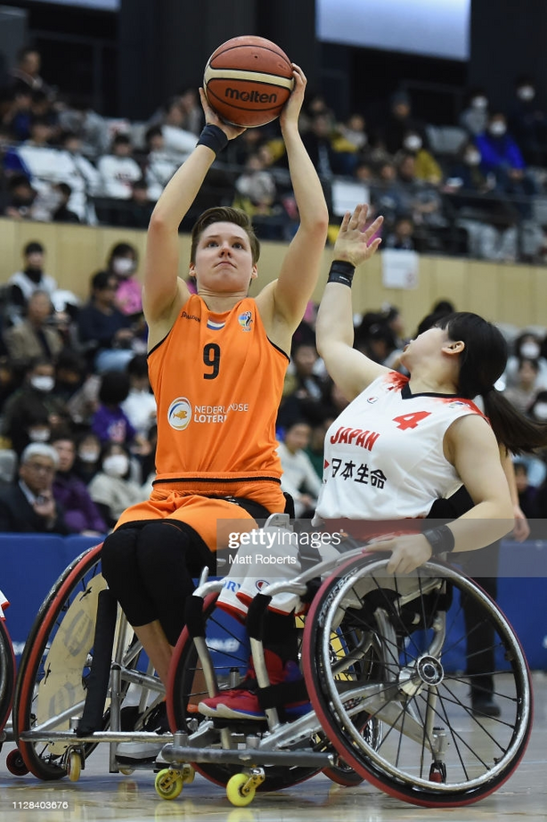
INTRODUCTION
Project Wheels
Background
Research question:
How can IMU data be used to identify wheelchair basketball-specific movements?
Sub-questions
Which form of data processing will be used?
Which specific movements can be detected?
Which sensor data is used for each movement?
Can movements be used to predict fatigue?
Can movements be used to detect overload?
Notes:
This year the Dutch wheelchair basketball team won the 2020 Paralympic games in Japan.
Rienk van der Slikke works as an embedded scientist for the women’s wheelchair basketball team. He installed IMU’s on the wheelchairs (internal measurement units), these contain accelerometers and gyroscopes. The sensors measure rotational acceleration. By using this data he wants to improve the statistical insights from training sessions and matches of the players. Right now, Rienk works with MATLAB to process the extracted data from the IMU’s. He wrote his own code to calculate the speed, acceleration, and rotation of the wheelchair. This data already gives the team insights to improve on.

Slide 4
Requirements
MUST HAVE
SHOULD HAVE
COULD HAVE
Link the data points to the timestamps
Calculating:
Top Speed
Rotation
Collision
Average speed
Fast break
Fast defence
Documentation
Presentation
Prediction
Fatigue
Detection
Slip
User manual
Prediction
Overload
Detection:
Repetitive movements
Classify player: explosive playing or stamina for a longer time
Notes:
In order to answer the research and sub questions we have made a few requirements. We divided the requirements in three categories: must have, should have and could have. Must have means that the requirements have to be implemented, should have means that it's our goal to implement them, but it's not necessary for the end goal. Could have means that the requirements could be added, but it isn't a priority.

Slide 5
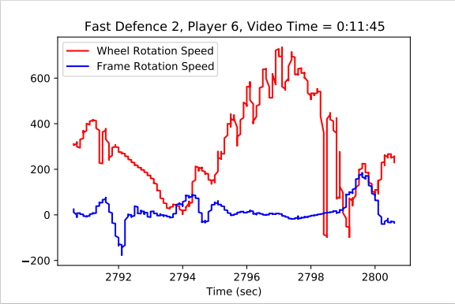
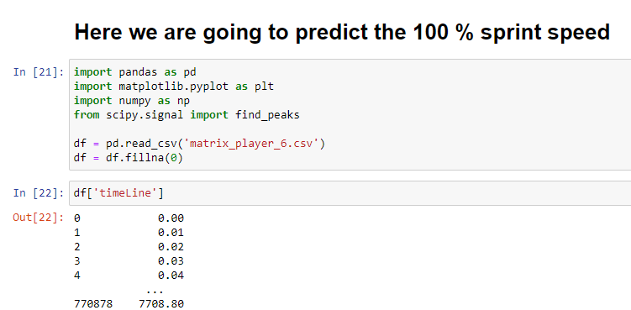
PROJECT ACTIVITIES
RESEARCH
Desk research
Defining the dataset
Applying the research to
execute pattern recognition
Determine the machine learning
PROGRAMMING
Dividing the tasks
Code
Test the code
Solve problems
Notes:
to meet these requirements the project group will complete the next project activities.
desk research:
researching different pattern recognition and machine learning to make a selection of usable machine learning algorithms in this project. the three the team ended up with at this time is KNN neigbours, naive bayes & descission tree.
defining the dataset:
in the last slide we saw a lot of wheelchair possible movements.
all these movements use variables. but what variables do we use for which movements.
applying the research:
applying the three desk researched techniques on the selected datasets to execute patern recognition and drom there determine the best perfoming machine learning algorythm.
when the reserach phase is complete, the programming starts. as a group we will devide the tasks wich need to be completed to get a working code.
when the code is fully written there will be a test phase to detect any issues and find ways to enhance the speed of the code.

Slide 6
END RESULT
RESEARCH PAPER
Document explaining the choice of the machine learning method
PROGRAM
Machine learning program classifying all the actions in combination with a matchtime
PROGRAM MANUAL
Code manual for the user
DATA RESULTS
Document with the results obtained from the program
Notes:
in the end
RESEARCH PAPER
Document that explains why among all the machine learning methods we've tried to apply, we chose (the one we use 'linear regression' for example)
PROGRAM
Code that classifies the data from a provided dataset through machine learning methods
PROGRAM MANUAL
Manual for the user to be able to use the program without knowledge in coding. This document will explain the user how to interact with the program in order to anlayse the data
DATA RESULTS
This document is created upon the use of the program and shows the results of the analysis and pattern recognition (specific actions and data) from the game

